Slide 1
Probability & Random Processes EE-2011 Department of Electrical Engineering
NATIONAL UNIVERSITY OF COMPUTER & EMERGING SCIENCES, LAHORE CAMPUS

Slide 2
2.2 Event
For any given experiment, we may be interested in the occurrence of certain events rather than in the occurrence of a speciﬁc element in the sample space.
To each event we assign a collection of sample points, which constitute a subset of the sample space.
That subset represents all of the elements for which the event is true.
For instance, we may be interested in the event A that the outcome when a die is tossed is divisible by 3.
This will occur if the outcome is an element of the subset A = {3, 6} of the sample space S in Example 2.1.
As a further illustration, we may be interested in the event B that the number of defectives is greater than 1 in Example 2.3.
This will occur if the outcome is an element of the subset
B = {DDN, DND, NDD,DDD} of the sample space S

Slide 3




Slide 4
Events
It is conceivable that an event may be a subset that includes the entire sample space S or a subset of S called the null set and denoted by the symbol φ, which contains no elements at all.
For instance, if we let A be the event of detecting a microscopic organism by the naked eye in a biological experiment, then A = φ.
Also, if
B = {x | x is an even factor of 7},
then B must be the null set, since the only possible factors of 7 are the odd numbers 1 and 7.

Slide 5
Events - Complement
Consider an experiment where the smoking habits of the employees of a manufacturing ﬁrm are recorded
A possible sample space might classify an individual as a non-smoker, a light smoker, a moderate smoker, or a heavy smoker
Let the subset of smokers be some event
Then all the non-smokers correspond to a diﬀerent event, also a subset of S, which is called the complement of the set of smokers

Slide 6

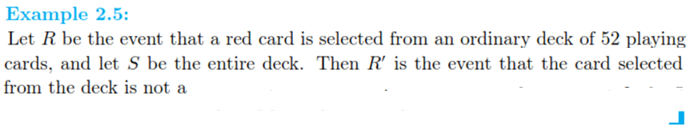
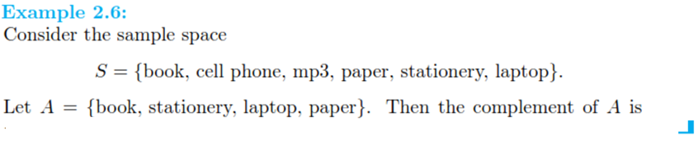

Slide 7
Intersection
We now consider certain operations with events that will result in the formation of new events.
These new events will be subsets of the same sample space as the given events.
Suppose that A and B are two events associated with an experiment.
In other words, A and B are subsets of the same sample space S.
For example, in the tossing of a die we might let A be the event that an even number occurs and B the event that a number greater than 3 shows.
Then the subsets A = {2, 4, 6} and B = {4, 5, 6} are subsets of the same sample space
S = {1, 2, 3, 4, 5, 6}.
Note that both A and B will occur on a given toss if the outcome is an element of the subset {4, 6}, which is just the intersection of A and B.

Slide 8

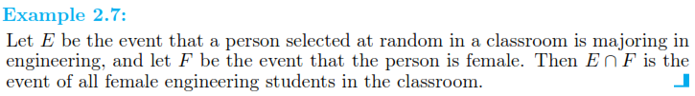
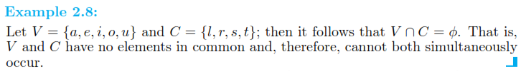

Slide 9

Mutual Exclusivity
For certain statistical experiments it is by no means unusual to deﬁne two events, A and B, that cannot both occur simultaneously.
The events A and B are then said to be mutually exclusive.
Stated more formally, we have the following deﬁnition:

Slide 10


Slide 11

Union
Often one is interested in the occurrence of at least one of two events associated with an experiment.
Thus, in the die-tossing experiment, if A = {2, 4, 6} and B = {4, 5, 6}, we might be interested in either A or B occurring or both A and B occurring.
Such an event, called the union of A and B, will occur if the outcome is an element of the subset {2, 4, 5, 6}.

Slide 12
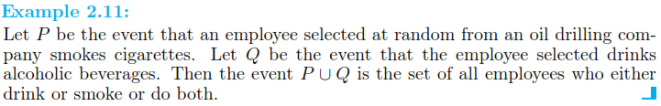


What will be M U N?

Slide 13
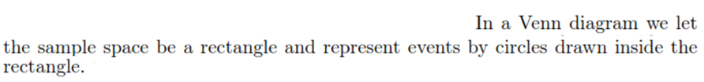
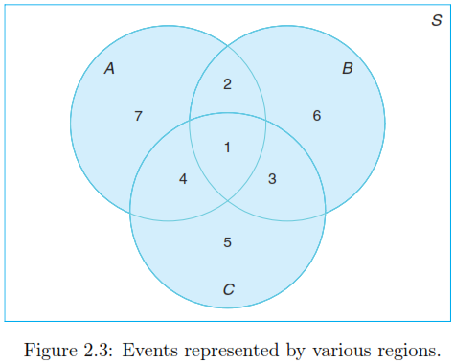

Slide 14









Slide 15
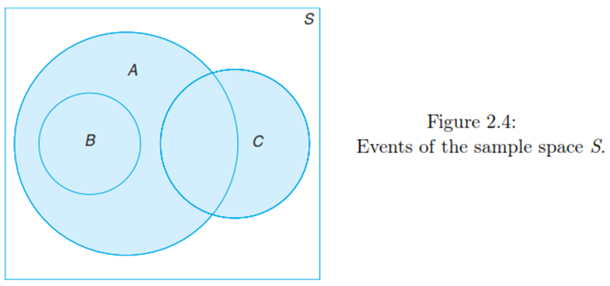

Slide 16



Slide 17









